Slide 1
BSP Home Loan
Date: Monday 27/11/2023
Presenter: Salome Ban

Slide 2
Contents
OVERVIEW
BSP HOME LOAN PRODUCT PACKAGE PROPOSITION
STANDARD FEATURES
TYPES OF PROPERTY PURCHASE
INDICATIVE LOAN REPAYMENT PLAN
HOME LOAN CUSTOMER JORNEY
APPROVED ACCEPTABLE VALUERS & INSURERS

Slide 3
Overview
Home ownership is an aspiration of most working class Papua New Guineans in their effort to provide security for their family and help them enhance their wealth creation opportunities.
The process of obtaining finance for a home can also be complex and time consuming with many people being unsure of how much they can borrow, the cost of borrowing and the choices available to them.
Papua New Guinea’s bank, BSP Financial Group Ltd would like to help as many families as possible to achieve their aspiration of home ownership and to do this, we provide the most affordable housing loan products in the market.

Slide 4
BSP Product Package Proposition
We offer the following home loan products to help you select the best deal and we also provide a comparison of our package to other home loan products offered by our competitors.
First Home Ownership Loan (FHOL)
Standard Home Loan (SHL)
Personal Property Investment Loan (PPIL)

Slide 5
BSP Home Loan Product Package Proposition First Home Ownership Loan (FHOL)
Standard Features
Loan amount: Minimum - K200,000 and Maximum: NIL
Maximum Loan Term: 40 years
Interest Rate : 4% fixed for 2years and 5.5% Variable thereafter
Equity: 10% (source from cash deposit, Superfund or Employer assistance via Home Ownership Scheme Policy) Where a borrower owns a state lease land with “clear” title, the value of such land can also be taken as equity contribution. Exemption: Borrowing to finance equity is not allowed
Bank Fees (Application Fee): K600 flat fee
Valuation & Insurance fees: Borrower to meet

Slide 6
BSP Home Loan Product Package Proposition First Home Ownership Loan (FHOL)
Eligibility Criteria
Must be PNG Citizen
Must be first home and must be owner occupied
Be employed over 12 months
Must not own, or partly own a property under a State Lease;
Spouse or defacto partner does not own or part own a property under a State Lease; and
Have not participated or applied under any other housing scheme arrangement.
Provide evidence of 10% equity

Slide 7
Type of Property to be Purchased under First Home Ownership Loan (FHOL)
The First Home Ownership Loan is specifically for the following:
Purchase of land under a State Lease for the construction of a new house;
Construction of a new house on land under a State Lease;
Purchase of land and house package under a State Lease; or
Purchase of an existing house, that is not more than 12 months old under a State Lease.
For Properties to be constructed , a developer/contractor/builder will have to meet certain conditions required by the Bank.

Slide 8
BSP Home Loan Product Package Proposition Standard Home Loan
Standard Features
Loan Amount: No minimum or maximum
Term: 40 years maximum
Interest Rate : 5.50% variable
Equity Requirement: 20% deposit which can be
made up of cash (including Super Fund/Employer's
contribution)
Bank Fees (Application Fee): K600 flat fee
Valuation & Insurance Fees: Borrower to meet
Refinance : Existing Home Loans held with other
banks and financial institutions can be refinanced

Slide 9
Type of Property to be Purchased under Standard Home Loan
The type of purchase under the Standard Home Loan facility are as follows:
Purchase a new or existing property on State Lease Title Land
Construct a new house on State Lease Title Land
Carry out maintenance or extension to an existing house on State Lease Title Land
Refinance an existing home loan
Refinance an existing home loan debt from a licensed financial institution

Slide 10
BSP Home Loan Product Package Proposition Personal Property Investment Loan – (PPIL)
Standard Features
Loan amount : Minimum - K 50,000.00 , No maximum
Interest rate: 8.75% variable pa
Term Of Loan: Maximum 15 years for Commercial , Maximum 25 years for Residential
Equity: 40%
Applicable Bank Fees :
- Application & Commitment Fee : 1.5% Application fee & 2.5 % commitment fee
Loan Service Fee: Applicable
Valuation & Insurance fees: Borrower to meet

Slide 11
Type of Property to be Purchased Personal Property Investment Loan – (PPIL)
A Personal Property Investment Loan is a facility to assist customers finance the purchase of a personal property for residential investment and commercial purposes.
Residential Investments properties are ;
Stand-alone houses
Individual units either company or strata title
Multi –unit residential units within a strata or company title complex
Commercial Investment properties are;
Commercial complexes and warehouses
Residential complex developments of more than six units
Note: If owner resides in the property and operates his/her business request can be also considered under SME Loan or PPIL.

Slide 12
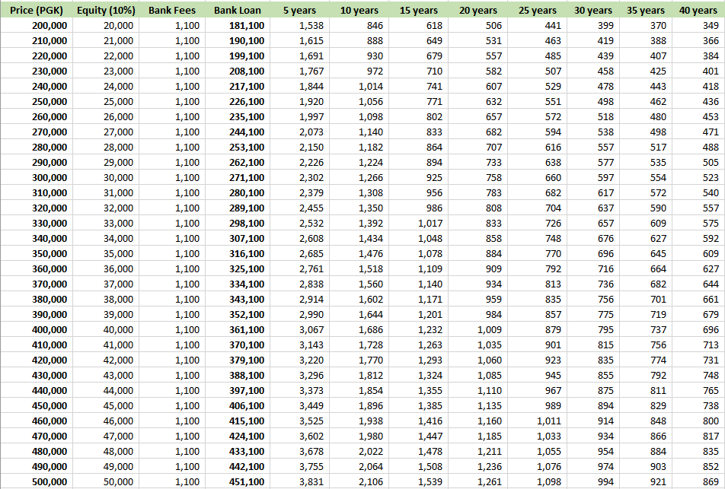
Indicative Loan Repayment Plan - Per Fortnight First Home Ownership Loan (FHOL)

Slide 13
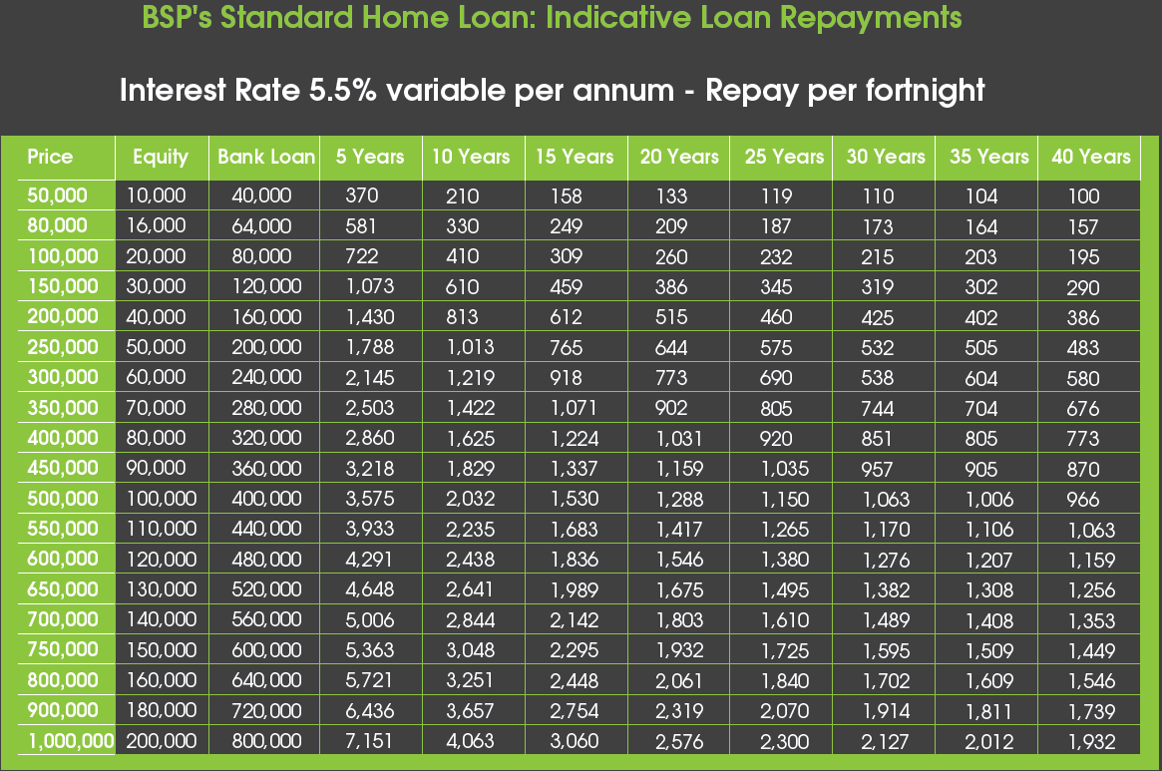
Indicative Loan Repayment Plan – Per Fortnight Standard Home Loan

Slide 14
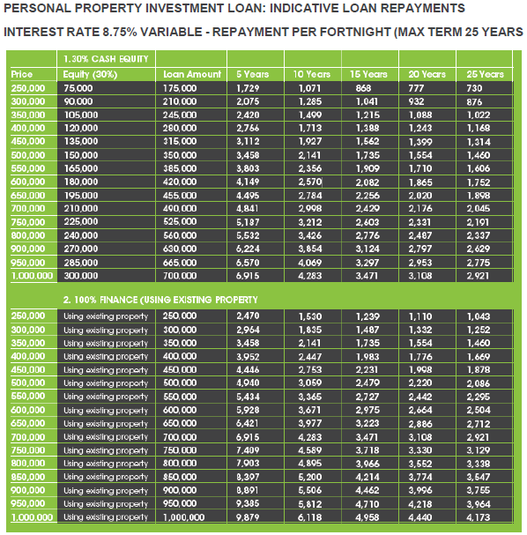
Indicative Loan Repayment Plan – Per Fortnight Personal Property Investment Loan (PPIL)

Slide 15
Home Loan Process
NEED Home Refinancing from Other bank Maintenance/extension Property Investment | GET INFORMATION Home Loan Specialists on - Phone: 305 7694/305 6367 - Email: _HomeLoans@bsp.com.pg - Website: www.bsp.com.pg | REQUIREMENTS Fully completed BSP Loan Application Copy of 3x latest pay slips Letter of Employment Valid ID Offer & Acceptance Letter Copy of Title Deed Evidence of Equity (FHOS -10%, Home Loan - 20%, PPIL - 40%) Statement of outstanding debts 6months Bank Statement if you bank with another bank
APPLY BSP Branch - Lending Section Email:_HomeLoans@bsp.com.pg | DECISION 24 hours turn-round Approved Declined | REVIEW/SIGN LOAN CONTRACT Meet Lending Sales Officer Mortgage Loan Contract
CONVEYANCING & SETTLEMENT Title Search Valuation Insurance Stamp Duty | MONEY IN THE ACCOUNT Settlement Funding - 48 hours | Annual Outgoing to be continued after settlement
15

Slide 16
Approved Panel of Valuers
Bank (BSP) only accepts the following valuers listed below;
16

Slide 17
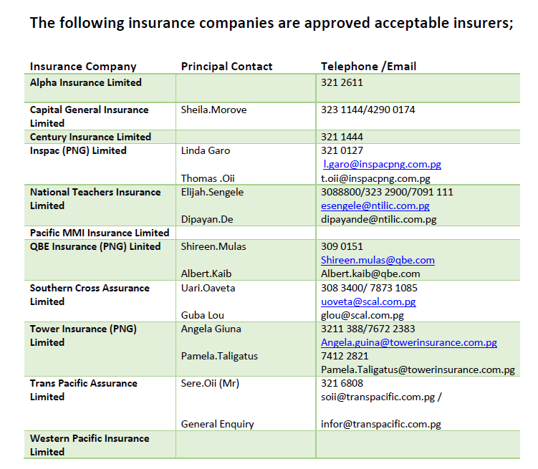
Approved Acceptable Insurers
17

Slide 18
BSP KEY CONTACTS
Retail Team | Salome Ban (Ms) Branch Manager Boroko Lending Centre Tel: +675 305 7723 CUG: 7091 7224 Email: SBan@bsp.com.pg | Stanislaus Mu’uh (Mr) Assistant Home Loan Coordinator Tel: +675 305 6367 CUG: +675 703 11462 Email: Smu’uh@bsp.com.pg
 | Helen Hau (Ms) Home Loan Coordinator – Retail Tel: +675 305 7694 CUG: +675 709 18 227 Email: HHau@bsp.com.pg | Marie Stella Airi (Ms) Team Leader Lending Sales| Retail Bank_Boroko Lending Centre Section 387, Lot 22 & 23, TST Supermarket Complex, Boroko T: + 675 305 7157 E: mairi@bsp.com.pg:
 | Molong Bole (Mrs) Team Leader – Lending Tel: +675 302 5309 CUG: +675 709 06 338 Email: Mbole@bsp.com.pg | Group Email _RetailLendingCenterManagement@bsp.com.pg

